Slide 1
Data Preparation
CS3300 Data Science
RJ Nowling

Slide 2
Feature Scaling and Transformation

Slide 3
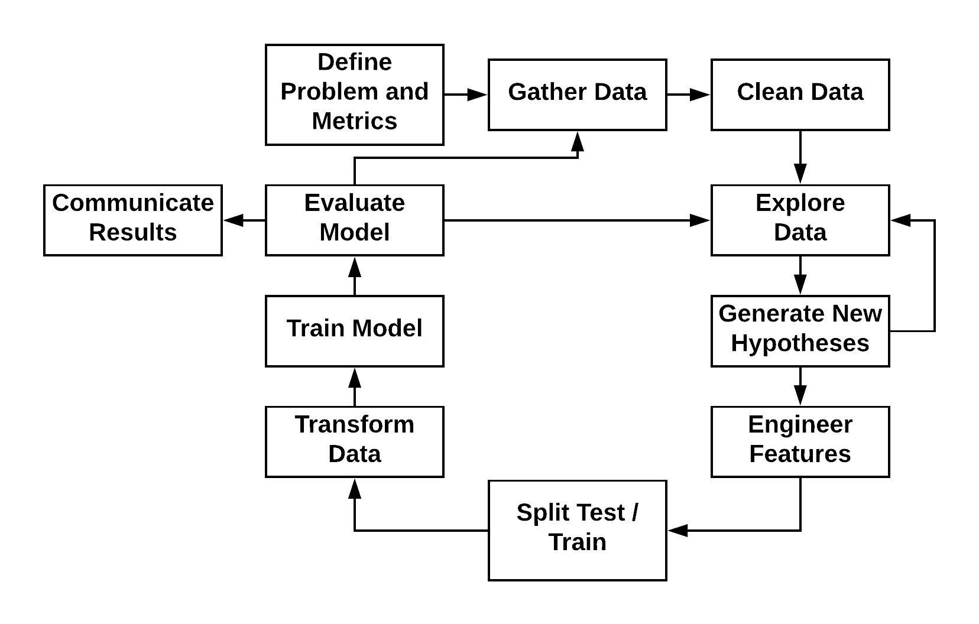
Machine Learning Process

Slide 4
Missing Data and Imputation
This is where we deal with missing data
For numerical features, missing data is represented as NaNs
Software will crash when you attempt to do math with NaNs
For categorical features, all dummies are 0 – no problems
We have to maintain our experimental setup:
Training the imputer on training set records with known values
Impute the missing values in the training and testing sets with that average value

Slide 5
Imputation: Mean or Mode
A simple imputation strategy
Calculate the mean, median, or mode of known values
Replace missing values with calculated value
Tends to be safe in that imputed values will not bias ML models
Most common practice
May not be appropriate:
e.g., using an average birth year for for historical figures

Slide 6
SimpleImputer
from sklearn.preprocessing import Imputer
imputer = Imputer()
train_df["my_column"] = imputer.fit_transform(train_df["my_column"])
test_df["my_column"] = imputer.transform(test_df["my_column"])

Slide 7
Imputation: Nearest Neighbor
More complex strategy
Find similar records using other fields with known values
Use known values from similar records to impute missing value
Not many good (robust) implementations available
May fail when a large number of records have missing values
Complex
Requires transforming data (feature engineering, scaling) to work well
Basically doing machine learning at that point

Slide 8
Scaling
Many machine learning algorithms do better when variables have the same ranges and an average value of 0
We can scale the values of the variables without changing their overall distribution

Slide 9
Scaling
from sklearn.preprocessing import StandardScaler
scaler = StandardScaler()
train_df["my_column"] = scaler.fit_transform(train_df["my_column"])
test_df["my_column"] = scaler.transform(test_df["my_column"])

